Slide 1
Tog Coders Night 1#
About C Language
By Paul McQuade <paulmcquad@gmail.com>
Twitter: @paulmcquad
https://github.com/paulmcquad/Tog-Coders-Night

Slide 2
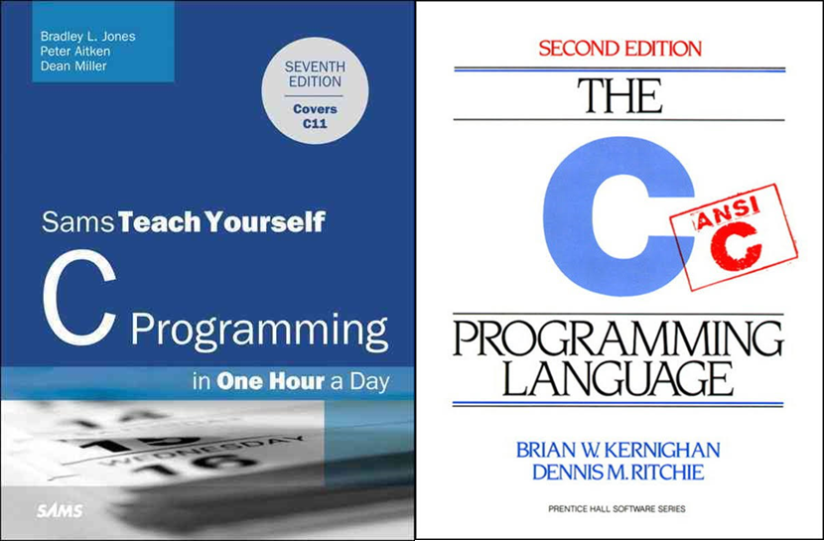
C Programming Books
The C Programming Language 2nd Edition
ISBN-13: 978-0131103627
C Programming in One Hour a Day, Sams Teach Yourself (7th Edition) 7th Edition
ISBN-13: 978-0789751997

Slide 3
Why C is better than C++
Linus Torvalds on C++
http://harmful.cat-v.org/software/c++/linus
Why would anybody use C over C++?
https://stackoverflow.com/questions/497786/why-would-anybody-use-c-over-c

